Slide 1
Memory Forensics 101
-An Incident Responders Tale
Event Name: ROOT LINK - 2024
Date: 06-Jan-2024

Slide 2
$ whoami
Aravindhan R
M.Sc Cyber Forensics and Information Security
Security Engineer - SecOps, Freshworks

Slide 3
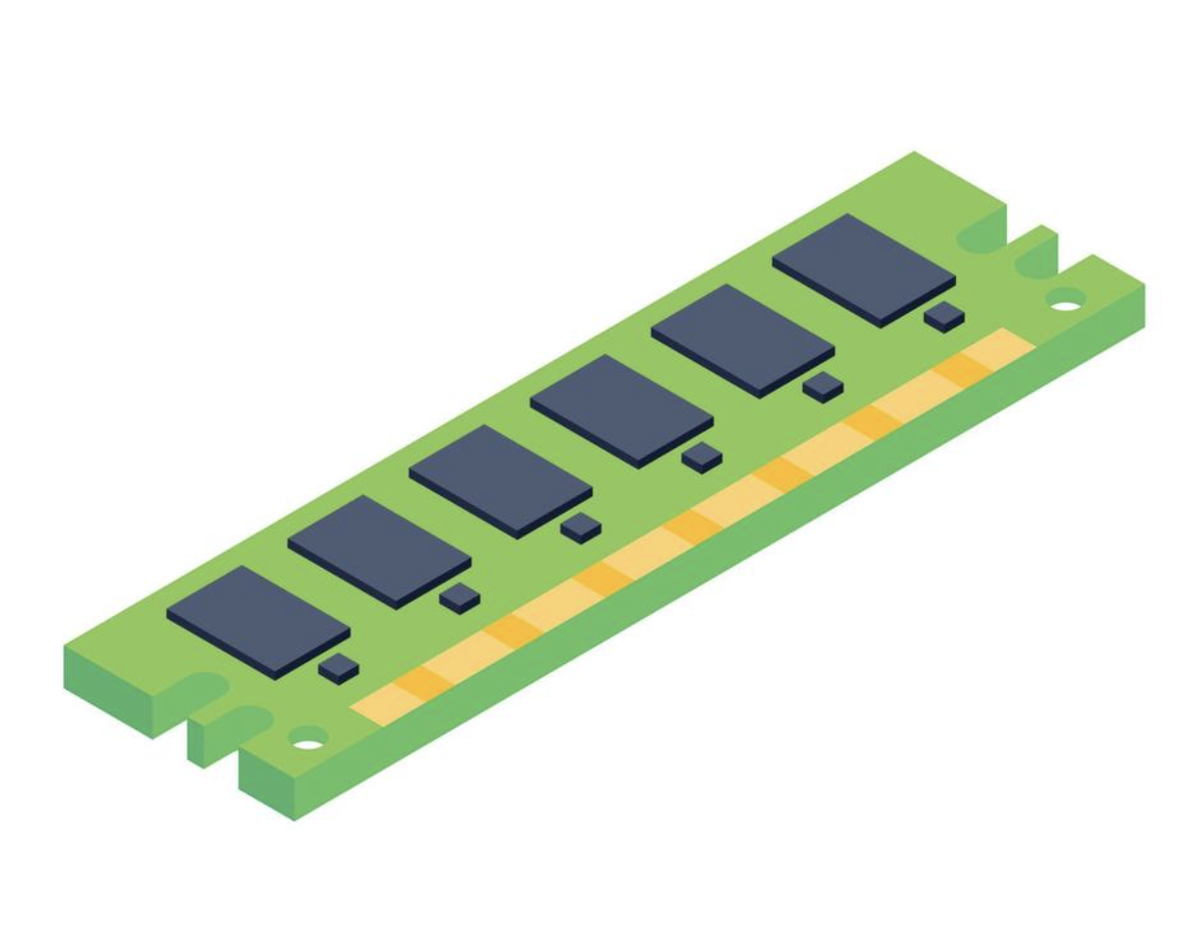
Basic about Memory
Types of Memory
Primary
Secondary
Order of Volatility

Slide 4

Why Memory Forensics Required
Commands Executed
Network Connections
Processes
Fileless Malwares

Slide 5
Memory Capturers
WinPmem (Windows)
FTK Imager (Windows/Linux)
Magnet RAM Capture (Windows)
AVML - Acquire Volatile Memory for Linux
dd (Linux/Unix)

Slide 6
Tools used for memory analysis
Autopsy
Mandiant Redline
GRR
Volatility 3

Slide 7
Investigation
Lets Investigate a memory file…

